Slide 1


The Learning Quality Framework

Slide 2
Schools with aspirations for learners
Does your school aspire to:
equip young people to take responsibility for their own learning and prepare them for 21st century life ?
make world-class learning your educational goal?
surpass any inspection framework’s expectations for teaching and learning with ease and confidence?
nurture greater autonomy, creativity and independence of thought in young people?
play a more expansive educational game?
Notes:
Build your vision for education

Slide 3
The Learning Quality Framework:
makes these vital, challenging aspirations DO-ABLE;
has a Quality Standard at its core;
untangles and describes the features of a learning school;
offers steps in the learning journey;
promotes progression through review and/or verification;
is based on the learning sciences and principles of learning organisations.
Notes:
Introduces how the LQF works.
The LQF:
blends the ideas of a ‘learning organisation” and the
latest ideas in learning to learn (from the learning sciences and psychology of learning)
Aims to provide a route map for the learning journey.
It does not depend on the specific learning philosophy the school may be working with or towards. The framework works for any school that it is using the learning sciences to underpin their approach to learning. Schools may be using one or more of the following approaches. Habits of Mind, AfL, P4C, L2L, Building Learning Power, Visible Learning etc.

Slide 4
The Learning Quality Framework
A rigorous developmental framework to guide a school towards delivering outstanding learning, leading to:
  Creative, independent learners who achieve well and are prepared for the challenges of 21st century living
  Inspirational teaching that expands young people’s capacity and appetite to learn
  A collaborative learning culture that supports experimentation and personal responsibility for all
  .
Notes:
The LQF is for schools that see their (aspirational) purpose as one of developing students dispositional learning powers. (which will also raise achievement)
LQF can be viewed as a journey planner
The school makes the journey. LQF guides, steers, supports, ensures progression.

Slide 5
The Learning Quality Framework
The LQF scaffolds the school’s learning journey through;
a quality standard that captures key aspects of a school’s learning culture
materials and consultancy to assist in diagnosis and action planning
external reviews of progress or verification of levels
Notes:
The framework scaffolds the learning journey of the school by:
showing the route as a quality standard,
providing materials to support the journey, and then by
reviewing the school’s progress or verifying that the school has reached a level of the standard.

Slide 6
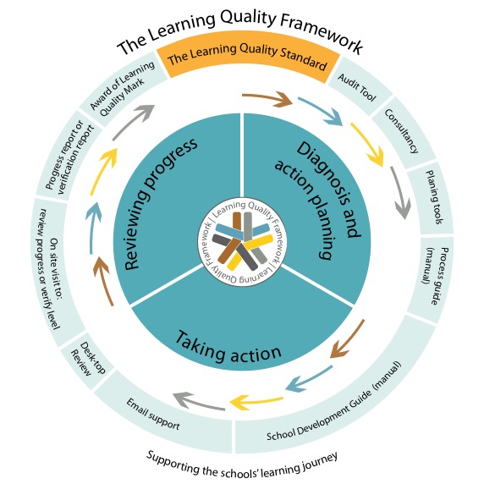
Notes:
This shows how the whole Framework supports the school’s journey.
Central circle= what schools do.
Outer ring shows how bits of the Framework work alongside the school to support the journey.

Slide 7
What does such an aspiration encompass?
Teaching culture
Changing ethos & habits
Assessment and progression
Vision
Student engagement
Learning Sciences
Communities of enquiry
A common language for learning
Learning culture
Leadership for learning
Changing ethos & habits
Curriculum design
Engagement of parents and communities
Commitment | Plans/strategies | Action | Evaluation
Notes:
But how big is this ambition/aspiration? What does it entail? Which aspects of a school does it affect?
Here’s a view of this;
The basic features that are needed to build a learning powered school.
.The school will need to develop/define a clear/focused vision for its educational role.
Leadership will need to promote and support a culture of dialogue, experimentation and monitoring.
The school’s approach to learning ( ie step beyond the narrow approach of merely teaching) will need to be based around research in the learning sciences
These features then enable learning communities for developing staff and, through a common language for learning, lead to changes in the ethos and habits of teaching, assessment, student engagement in the school, the learning environment, the design of the curriculum and how parents and the community are engaged to assist in growing learning habits.
Hence there is a vast web of interacting aspects of the school that need to work together to develop a learning school... through its commitment to the vision, through its plans and strategies, through the action it takes and through the way it evaluates and learns from its actions.

Slide 8
The LQF structure
4 Dimensions:
  Commitment, Planning, Action, Evaluation
12 Principles:
  based on different aspects of school culture
32 Indicators:
  how the principles are realised in practice across four phases of development
Notes:
Summarises how the LQF standard is structured
The 4 dimensions (how the Quality Standard is carved up) are: Commitment; Planning; Action; Evaluation ie as is Investors in People, a well know quality cycle
The 12 principles are concerned with different aspects of a school’s culture, such as its vision for education, its beliefs about learning, how leaders lead learning, how classroom practice, assessment and the curriculum are best designed to build learning habits, how staff are best enabled to adjust their practice, and how the school itself acts on its own learning.
The 32 indicators are the detail that sit behind the 12 principles. Indicators are spelled out for bronze, silver and gold stages but the platinum level requires the school to take the initiative and provide evidence that the have moved beyond gold. The QLF gives some examples of what this might look like but does not limit progression by defining this stage closely.
The 4 phases are Bronze (for schools who are starting out), Silver (developing their practice), Gold (Establishing and embedding best practice) and Platinum (Enhancing, going beyond Gold , extending into the communities)

Slide 9
LQF structure
Principles | Indicators
 | Bronze | Silver | Gold | Platinum
Commitment
1 Vision 2 Learning philosophy 3 Language of Learning
Plans/strategy
4 Leadership 5 CPD
Action
6 Curriculum 7 Teaching culture 8 Learning culture 9 Learner engagement 10 Parents
Evaluation
11 Assessment (learning habits) 12 Evaluation
Notes:
How the principles are divided amongst the dimensions of the standard. This shows a skeleton structure without the detail.

Slide 10
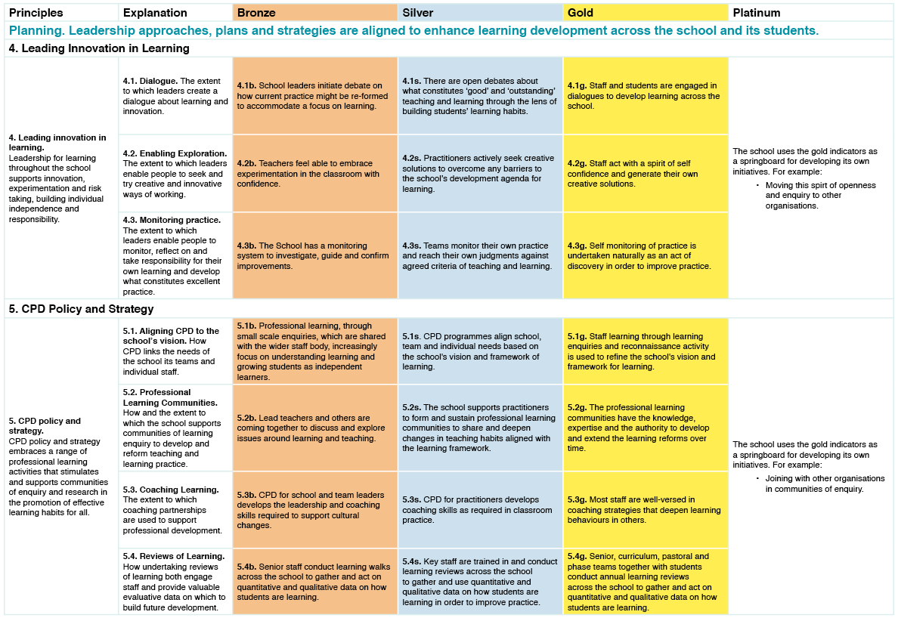
Layout of the Standard
Notes:
This shows how the standard is laid out.
The blue text shows a dimension, in this case Planning, and the 2 principles (column 1) that sit in this dimension ( leadership and CPD)
The next column shows what the line or thread of indicators is about.
The indicators are shown at bronze, silver and gold levels
By Platinum stage the school will initiate and define its own progress rather than follow given criteria. In the award of the Quality Mark the school will need to prove how they have moved well beyond Gold.

Slide 11
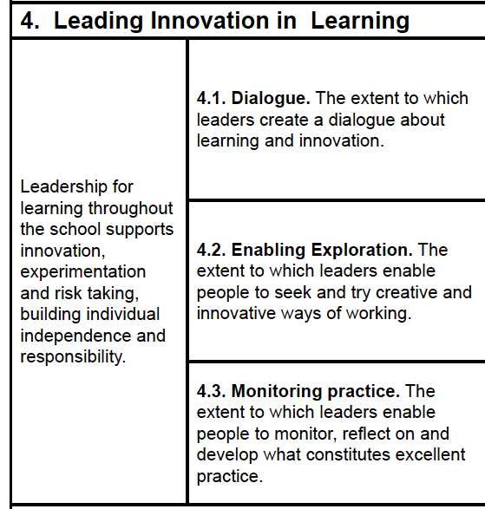
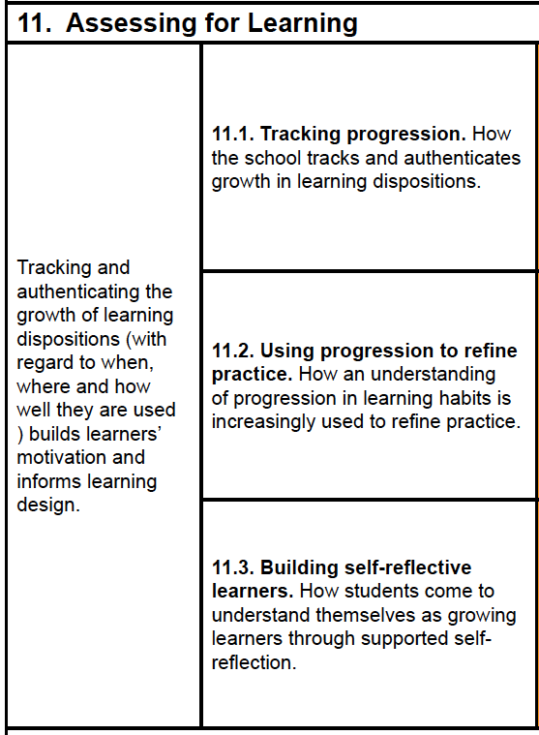
Principles; how they are fleshed out
Notes:
A flavour of how the principles are written.
Principle 4 Leading innovation in learning and then unpacked through three aspects of practice...4.1 Dialogue, 4.2 Enabling exploration, 4.3 Monitoring practice... which are then unpacked precisely in indicators (not shown here)
Similarly for Principle 11 Assessing for learning.

Slide 12
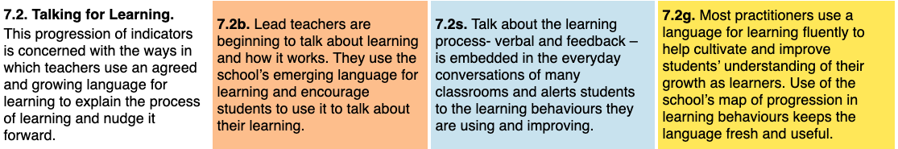
How threads of indicators grow
Notes:
Here’s a full thread of indicators. In this case talking for learning.
Bronze simply requires some teachers to be drawing students attention to learning and how it works
By silver there is a big leap to many classrooms where talk about the process of learning is alive and well and helping students to improve their use of learning behaviours
By gold the language of learning is used fluently by most teachers and is supported by the school’s map of progression of learning behaviours. This in turn ensures learners are engaged and progressing in developing learning habits
The indicators progress in 3 ways., the scope of the use of learning language in the school (ie how many teachers are ‘doing it’) The skilfullness of the teacher i.e. their fluency in the learning language and the impact of the learning language on students.

Slide 13
LQF – phases of development
Starting out (bronze)
  Beginning to have a radical re-think about the purpose of education,
  Casting around and trying out ideas.
Developing (silver)
  Has found or developed a ‘best-fit’ learning strategy,
  Increasingly putting this into practice.
Establishing (gold)
  Learning approach secured and working well,
  Deeply embedded, not reliant on a few leaders.
Enhancing (platinum)
  Continual enhancement,
  Impact now beyond the school.
Notes:
This is about the ‘levelness’ of the stages. What the whole stage is really about.
The Framework
Since the whole point of the framework is to describe a learning journey, the indicators or statements of practice are related to four phases of development; coherent staging points on the journey where you might take time to reflect and prepare for the next stage.
Stages
Starting out – when a school has realised there may be a bigger goal for education, or that they may actually be cultivating an attitude of dependency in pupils through too much spoon-feeding or that they are producing successful students but not necessarily good learners. For these schools the time has come for a radical rethink of their vision for learning. At this stage the school is actively casting around for and trying out ideas, building a culture of self-reliance and learning rather than dependency and performance. We unimaginatively label this the Bronze level/stage of the framework.
Developing – when a school has done its research, tried things out and has found or developed a ‘best-fit’ learning strategy for the school. At this stage it is developing its preferred approach to learning through classroom practice, CPD, leadership approaches and so on and gradually bringing its learning philosophy to life. We label this the Silver level/stage of the framework.
Establishing – when a school’s approach to learning is secured and working well. Here the approaches to pedagogy, CPD, student engagement, assessment and curriculum design are deeply embedded in the school’s culture and not reliant on a few leaders or champions. We label this the Gold level/stage of the framework.
Enhancing – when the school’s philosophy for learning is being continually developed and is impacting both in and beyond the school. The school is operating as a learning organization where all its people, staff and students alike, expand their capacity to create the results they truly desire and engage with other organizations to create wider cultures of learning. We label this the Platinum level/stage of the framework.

Slide 14
At Bronze level . . .
Indicator 7.2. Lead teachers are beginning to talk about learning and how it works. They use the school’s emerging language for learning and encourage students to use it to talk about their learning.
Documentary and/or video evidence from learning walks will show that this is beginning to happen.
  Observations will confirm that some teachers are taking opportunities that arise naturally to notice and discuss how students are learning during lessons and in review points.
  Interviews with lead teachers will show that teachers (usually through small scale enquiries) are exploring the effects of this and how to plan for it.
  Interviews with students of lead teachers will confirm that some students are developing a vocabulary with which to discuss the learning process.
Notes:
This slide gives more detail on the sort of practice the LQF is advocating/looking for. Bronze level is relatively easy. Far from full blown.

Slide 15
At Silver level . . .
Indicator 7.2 Talk about the learning process - verbal and feedback - is embedded in the everyday conversations of many classrooms and alerts students to the learning behaviours they are using and improving.
Documentary evidence from learning walks and learning reviews show that this is happening across a range of subjects / phases; Schemes of Learning and planning proformas will have been adapted.
  Observations confirm the above.
  Interviews with teachers will show that they are able to use the learning language relatively fluently. They are becoming increasingly at ease with this way of working
  Interviews with students will demonstrate that most students are able to discuss the learning process clearly and confidently, using the school's language for learning.
Notes:
Big jump in expectations here. Most lessons will be carried out with a learning language to the fore

Slide 16
At Gold level . . .
Indicator 7.2 Most practitioners use a language for learning fluently to help cultivate and improve students’ understanding of their growth as learners. Use of the school’s map of progression in learning behaviours keeps the language fresh and useful.
Documentary evidence demonstrates that Schemes of Learning and planning proformas etc. show planned progression.
    Observations will confirm that most lessons are characterised by: dual focused learning outcomes; fluency and purpose in the learning language; review points that routinely address both content acquisition and the effect of the learning process.
    Interviews with teachers will show that teachers are comfortable with working in this way and that they are fluent in the school’s chosen language of learning.
    Interviews with students will demonstrate that they are able to discuss the learning process clearly using the school's language for learning and have an accurate sense of how they are developing as learners.
Notes:
At gold level the language of learning is alive and well across the school and is enabling students to grow as learners.

Slide 17
Using The Learning Quality Framework
Four useful functions:
Diagnostic
  assess current position (secure, develop, start).
Formative
  develop plans based on the indicator paths.
Summative
  external review and/or formal verification of progress.
Evaluative
  report guides further development.
Notes:
The different uses of LQF
Diagnostic – it enables the school to assess where it is now on its learning journey. By considering the Principles and the three levels of indicators the school can gauge which are secure, which need development and which need starting from scratch.
Formative – The different types and levels of indicators provide the school with a way forward. From the analysis of ‘what is’ against the Framework, the school can develop a strategic development plan of action.
Summative – The school can be externally reviewed or verified against each level of the framework. A formal verification (rather than a review`) will result in the opportunity for public recognition through the award of a Learning Quality Mark.
Evaluative – When the school is assessed it receives a report which acts as an external validation of its progress to date. The report can be used as part of the school’s SEF and proof of self-evaluation.

Slide 18
Support for the LQF learning journey
Phase 1 – Diagnosis and action planning:
  An online step by step journey guide from audit through to assessment and beyond offering:
  The LQF standard in full
  Self-audit tools
  Other tools to aid development planning
  The School Development Guide – a ‘manual’ that unpacks the indictors and suggests how you might achieve them
  A Level Review Chart for detailing evidence
Notes:
The LQF is available in two linked phases.
These are available as a online bank of resources.
Phase 1
A variety of items which the school can use to diagnose where it is, plan action and evaluate its progress.
Many items are available electronically.
The self audit tool gives all the principles and indicators and invites schools to assess where these are secure, in need of development, or need to be started from scratch. Schools may find they are well advanced in some areas but barely ‘working towards’ in others.
The other electronic tools are designed to help the school get closer to an Action Plan. They focus on the one level the school has selected to work on in response to answers in the audit. They help the school to answer why they think certain indicators are secure and pose questions about the indicators requiring work to nudge tem closer to an Action Plan
The School Development guide gives a page of advice on every indicator; what it looks like in practice and the questions schools need to ask themselves to be sure they are in fact meeting the indicator stage. See next slide
.The Level Review Chart is an electronic tool, one for each level, which the school completes for the level they wish to submit for external review or verification. Here the school summarises the sort of things they have done for each indicator and the type of evidence they can be assured of. This is sent to the consultant who will use this information to plan the review.
A school will find this package an invaluable guide for their journey.
TLO offers consultancy for any aspect of the LQF process ie audit, action planning, preparing for assessment etc.

Slide 19
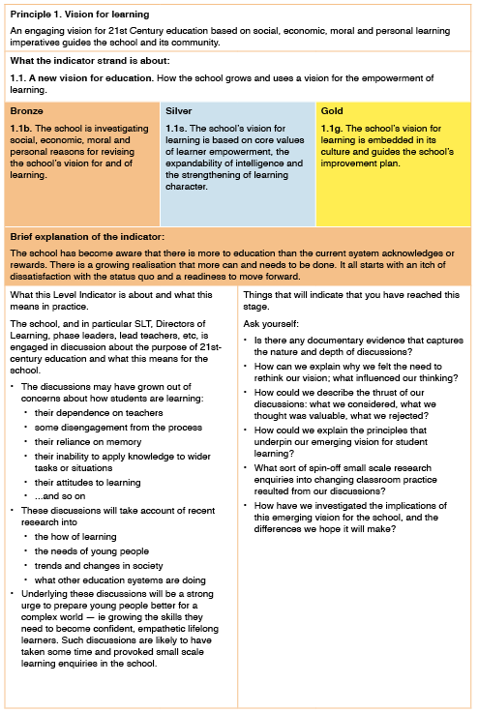
Development guide – example page
Notes:
One page from the Development Guide.
It shows the indicator being explained (in this case 1.1 bronze) plus the others in the series. This helps schools to keep the next stage of the journey in mind.
Each page gives a brief explanation of an indicator and the 2 columns give more detail about what it means in practice (LH column) and questions about the sort of evidence that the school might look for to convince themselves and others that the practice is robust (RH column).
i.e. your practice should look like column 1 and if you can’t answer questions in column 2 you are probably not at the standard required.
.

Slide 20

Recognising success in the LQF journey
20
Phase 2 – Review and/or Verification Processes:
  A desk-top pre-verification check
  A planning tool, to help schools to prepare for review or verification
  Phone and email support prior to verification
  An on-site visit to conduct interviews, lesson observations, a school; tour and documentation scrutiny(for above Bronze level)
  A report, based on the evidence, to assist future planning
  Award of a Learning Quality Mark on reaching a verified level.
Notes:
Details of the 2nd phase of the LQF.
Schools generally value external assessment to validate the security of their evidence and use accreditation to recognise and celebrate their achievements
At this stage schools can choose either to have a review of progress (to get a picture of how they are doing before moving on) OR a level verification (to assess whether the school has reached/secured a level in the standard).
We offer a pre-verification check of the school’s Level Assessment Chart. This is to make sure the school has enough evidence for each indicator and that it would be worth them going ahead with an verification. We don’t want schools to go through a formal verification process if they are evidently not ready for it.
A Planning tool is sent from the consultant to the school to help them organise the review or verification visit.
Primary visits will be undertaken in one day, secondary in two.
Assessments do not require a portfolio of paper evidence. In fact most of the evidence will be obtained through interviews with staff, leaders and students. classroom observations and a tour of the school. Most schools do however like to put documentary evidence together.
The review or verification report gives clear guidance about what needs to be done to reach the next stage for each principle.
It is a substantial document which describes how a stage has been reached with suggestions about what to do next.
If a school has reached a level in the standard (as verified by a report) the school can apply for the award of a Learning Quality Mark. Some schools may not want to receive public recognition of their progress, hence the LQMark is not compulsory.
.
There is a process of quality assuring the verification reports to ensure the Quality Mark is being judged fairly and at a consistent level.
The Quality Mark is awarded through the Centre for Real-World Learning in association with the University of Winchester.
The school will be sent a certificate for display in the school and a logo to put on their stationary.
The award is given for 3 years.

Slide 21
Benefits of The Learning Quality Framework
it provides the big picture and the staged journey towards the most important aspiration for your school
it aligns you to the most demanding challenge you have
it will form the basis of your school development plan for years ahead
it stimulates you to think deeply about learning and - since you are an experienced professional - enables you to generate your own answers and solutions.
Notes:
Returning to the purpose and benefits of the LQF.
The development as a learning school is, we believe, the most important, difficult and vital journey a school can take.
The LQF keeps schools on track.
It will act as the school’s development plan for several years.
But the LQF doesn’t do the job for the school.
It treats people as professionals, it isn’t a box ticking exercise; it poses questions and coaches the school through the journey.
It’s an essential tool for a worthwhile journey.

Slide 22
The Learning Quality Framework
Notes:
End

